Slide 1
Computer System Architecture
UNIT-4
By Neha Gulati

Slide 2
overview
Memory Organization
Memory Hierarchy
Main Memory
Auxiliary Memory
Associative Memory
Cache Memory
Virtual Memory
Memory Management Hardware

Slide 3
MEMORY HIERARCHY
The memory unit is an essential component in any digital computer since it is needed for storing programs and data.
Not all accumulated information is needed by the CPU at the same time.
Most general-purpose computers would run more efficiently if they were equipped with additional storage beyond the capacity of the main memory.
Therefore, it is more economical to use low-cost storage devices to serve as a backup for storing the information that is not currently used by CPU.
The memory unit that communicates directly with the CPU is called the main memory.
Devices that provide backup storage are called auxiliary memory. The most common auxiliary memory devices used in computer systems are magnetic disks and tapes.

Slide 4
Contd…
A special very-high speed memory called a cache is sometimes used to increase the speed of processing by making current programs and data available to the CPU at a rapid rate.
The cache is used for storing segments of programs currently being executed in the CPU and temporary data frequently needed in the present calculations by making programs and data available at a rapid rate, it is possible to increase the performance rate of the computer.

Slide 5
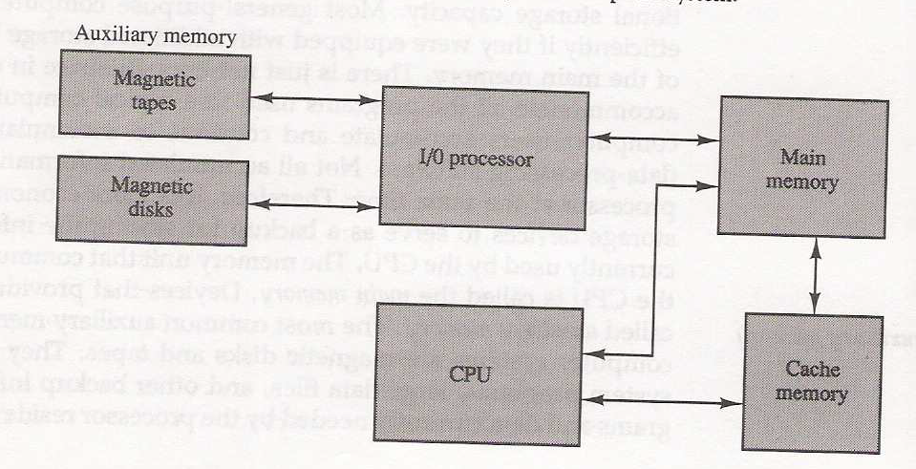
Contd…
The main memory occupies a central position by being able to communicate directly with the CPU and with auxiliary memory devices through an I/O processor.
While the I/O processor manages data transfers between auxiliary memory and main memory, the cache organization is concerned with the transfer of information between main memory and CPU. Thus each is involved with a different level in the memory hierarchy system.

Slide 6
Contd…
Why we have different levels of memory?
The reason for having two or three levels of memory hierarchy is economics.
As the storage capacity of the memory increases, the cost per bit for storing binary information decreases and the access time of the memory becomes longer.
The auxiliary memory has a large storage capacity, is relatively inexpensive, but has low access speed compared to main memory.
The cache memory is very small, relatively expensive, and has very high access speed. Thus as the memory access speed increases, so does its relative cost.

Slide 7
Contd…
The typical access time ratio between cache and main memory is about 1 to 7. For example, a typical cache memory may have an access time of 100ns, while main memory access time may be 700ns. Auxiliary memory average access time is usually 1000 times that of main memory.

Slide 8
MAIN MEMORY
The main memory is the central storage unit in a computer system.
Primary memory holds only those data and instructions on which computer is currently working.
It has limited capacity and data is lost when power is switched off.
It is generally made up of semiconductor device.
These memories are not as fast as registers.
The data and instruction required to be processed reside in main memory.
It is divided into two subcategories RAM and ROM.
RAM– Random Access memory
ROM– Read Only memory

Slide 9
RANDOM ACCESS MEMORY (RAM)
RAM (Random Access Memory) is the internal memory of the CPU for storing data, program, and program result.
It is a read/write memory which stores data until the machine is working. As soon as the machine is switched off, data is erased.
RAM is volatile, i.e. data stored in it is lost when we switch off the computer or if there is a power failure.
RAM is of two types-
Static RAM (SRAM)
Dynamic RAM (DRAM)

Slide 10
Contd…
Static RAM (SRAM)
Consists of internal flip-flops that store binary data.
Each cell stores bit with a six-transistor circuit.
Retains value indefinitely, as long as it is kept powered.
Relatively insensitive to disturbances such as electrical noise.
Faster (8-16 times faster) and more expensive (8-16 times more expensive as well) than DRAM.
Characteristic of Static RAM
Long life
No need to refresh
Faster
Used as cache memory
Large size
Expensive
High power consumption

Slide 11
Dynamic RAM (DRAM)
Each cell stores bit with a capacitor and transistor.
Value must be refreshed every 10-100 ms.
Sensitive to disturbances.
Slower and cheaper than SRAM.
Characteristics of Dynamic RAM
Short data lifetime
Needs to be refreshed continuously
Slower as compared to SRAM
Used as RAM
Smaller in size
Less expensive
Less power consumption

Slide 12
RAM CHIP
A RAM chip is better suited for communication with the CPU if it has one or more control inputs that select the chip when needed
The Block diagram of a RAM chip is shown , the capacity of the memory is 128 words of 8 bits (one byte) per word.
Uses bidirectional data bus to transfer the data from CPU to Memory or Memory to CPU.
The size of memory is 128 X 8 which can be written as
2⁷ X 8 (as 2⁷ = 128)
This means 7 bits are used for address bus & 8 bits for data bus.

Slide 13
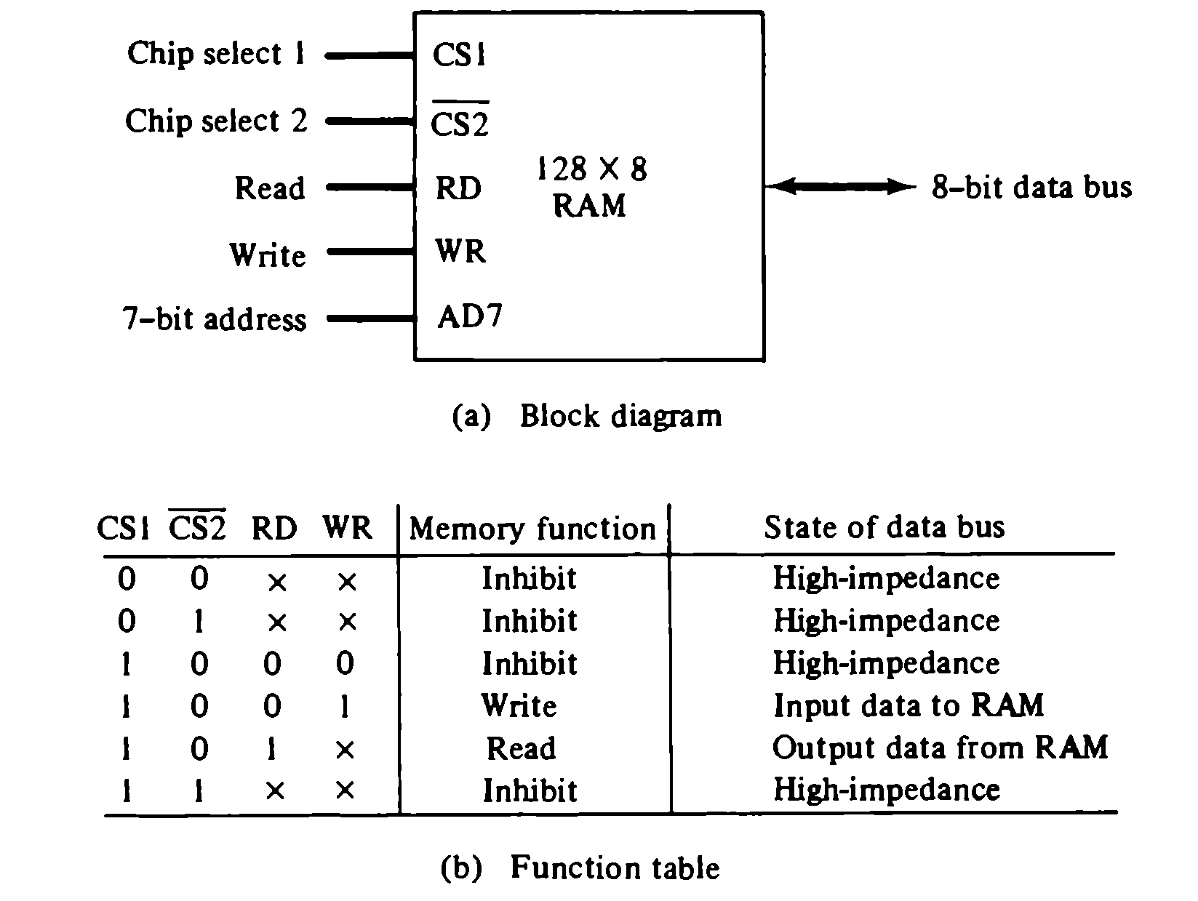
The block diagram of a RAM chip is shown in Fig. The capacity of the memory is 128 words of eight bits (one byte) per word. This requires a 7-bit address and an 8-bit bidirectional data bus.

Slide 14
Explanation-
The unit of RAM is functional only when CS1 = 1 and CS2’=0.
The bar on CS2 indicates that this is enabled when it is equal to 0.
If any of the chip select is disabled or if they are enabled but read/write are disabled, then memory is inhibited and its data bus are in high-impedence state.
When CS1=1 and CS2’=0 the memory can be placed in read or write mode.
When WR=1, memory stores a byte from data bus into location specified by address lines.
When RD=1, the content of selected byte is placed into data bus.

Slide 15
ROM
ROM is used for storing programs that are PERMENENTLY resident in the computer and for tables of constants that do not change in value once the production of the computer is completed
The ROM portion of main memory is needed for storing an initial program called bootstrap loader, witch is to start the computer software operating when power is turned off

Slide 16
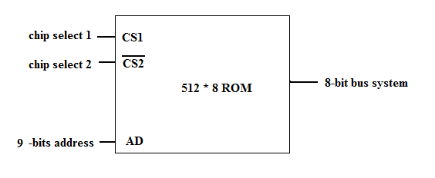
Rom chips
A ROM chip is organised in similar manner.
Since a ROM can only read, the data bus can only be in output mode.
The 9 address lines in the ROM chips specify any of the 512 bytes stored in it as 2⁹= 512.
Chip select inputs must be CS1=1 and CS2’=0 for unit to operate.
There is no need for read/write control as unit can only read.

Slide 17
Memory Address Map
The interconnection between memory and processor is then established form knowledge of the size of memory needed and the type of RAM and ROM chips available.
The addressing of memory can be established by means of a table that specifies the memory address assigned to each chip.
The table, called a memory address map, is a pictorial representation of assigned address space for each chip in the system.

Slide 18
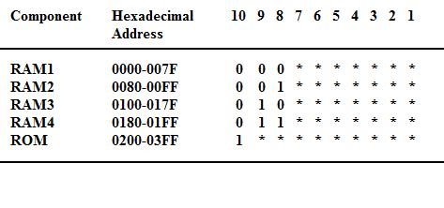
Example of memory address map
Assume a computer system needs 512 bytes of RAM and 512 bytes of ROM.
The RAM and ROM chips can be used with configuration as 128 x 8 for Ram and 512 X 8 for ROM.
Total memory for RAM is 512 so we need 4 RAM (as one RAM is of 128 size so to complete 512 bytes we need 4 RAMs).

Slide 19
Contd…
Although there are 16 lines in address bus but only 10 are shown because other 6 are not used and assumed to be zero in this example.
The RAM chips have 128 bytes, so they need 7 address lines (2⁷= 128).
The ROM chip has 512 bytes, so they need 9 address lines (2⁹= 512).
Lines 1 to 7 are for RAM and lines 1 to 9 are for ROM.
It is necessary to distinguish between four RAM chips, for that we choose lines 8 & 9 to represent four distinct binary combinations. When 00, RAM 1 is selected, when 01 then RAM 2 and so on..
The distinction between a RAM and ROM address is done with another bus line i.e., 10. When line 10 is 0, the CPU selects a RAM and when this line is 1, it selects the ROM.

Slide 20
AUXILIARY MEMORY
Auxiliary memory (also referred to as secondary storage) is the non-volatile memory lowest-cost, highest-capacity, and slowest-access storage in a computer system.
It is where programs and data kept for long-term storage or when not in immediate use.
The most common auxiliary memory devices used in computer systems are magnetic disks and tapes.
Other components used, but not as frequently, are magnetic drums, magnetic bubble memory, and optical disks.

Slide 21
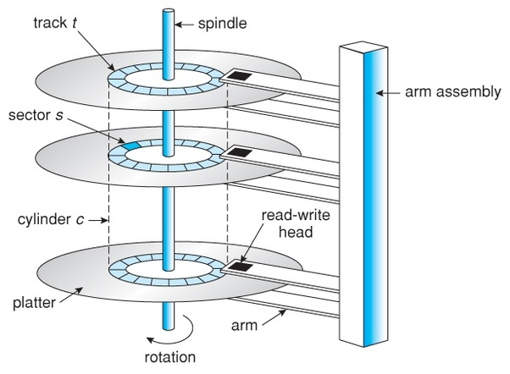
Magnetic disks
Magnetic disks are the most common form of secondary storage for your computer system. That’s because they provide fast access and high storage capacities at a reasonable cost.

Slide 22
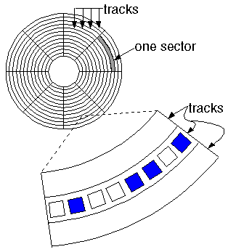
Contd…
Magnetic disk has a spindle (vertical shaft) around which we can attach various platters.
All platters are attached to same spindle and rotate at same speed typically at speed of 3,600 to 7,600 revolutions per minute (rpm).
A platter has 2 surfaces, one on top & another at bottom both coated with an iron oxide recording material.
The disk surface is divided into concentric tracks (circles within circles). The thinner the tracks, the more storage. The data bits are recorded as tiny magnetic spots on the tracks. The smaller the spot, the more bits per inch and the greater the storage.

Slide 23
Contd..
Electromagnetic read/write heads are positioned by access arms between the slightly separated disks to read and write data on concentric, circular tracks.
Data are recorded on tracks in the form of tiny magnetized spots to form the binary digits of common computer codes.
Thousands of bytes can be recorded on each track, and there are several hundred data tracks on each disk surface, thus providing you with billions of storage positions for your software and data.
Tracks are concentric circles on the disk, broken up into storage units called "sectors." The sector, which is typically 512 bytes, is the smallest unit that can be read or written.
For example, READ SECTOR 782, WRITE SECTOR 5448. In order to update the disk, one or more sectors are read into the computer, changed and written back to disk. The operating system figures out how to fit data into these fixed spaces.

Slide 24
MAGNETIC TAPE
A magnetic tape transport consists of the electrical, mechanical, and electronic components to provide the parts and control mechanism for a magnetic-tape unit.
The tape itself is a strip of plastic coated with a magnetic recording medium.
Bits are recorded as magnetic spots on the tape along several tracks.
Usually, seven or nine bits are recorded simultaneously to form a character together with a parity bit.
Read/write heads are mounted one in each track so that data can be recorded and read as a sequence of characters.
The major drawback of tape is its sequential format. Locating a specific record requires reading every record in front of it or searching for markers that identify predefined partitions.
Although most tapes are used for archiving rather than routine updating, some drives allow rewriting in place if the byte count does not change. Otherwise, updating requires copying files from the original tape to a blank tape (scratch tape) and adding the new data in between.

Slide 25
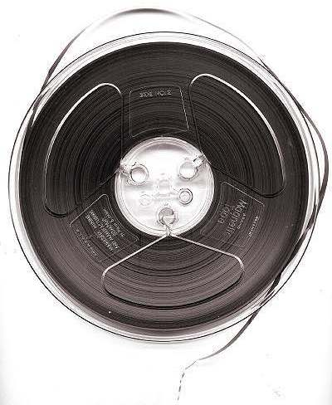

Slide 26
Contd…
Tape has been more economical than disks for archival data, but that is changing as disk capacities have increased enormously. If tapes are stored for the duration, they must be periodically recopied or the tightly coiled magnetic surfaces may contaminate each other.
Magnetic tape has been used for offline data storage, backup, archiving, data interchange, and software distribution, and in the early days (before disk storage was available) also as online backing store.
For example, although tape is a nonvolatile medium, it tends to deteriorate in long-term storage and so needs regular attention (typically an annual rewinding and inspection) as well as a controlled environment. It is therefore being superseded for archival purposes by optical disk.
Magnetic tape is still extensively used for backup; for this purpose, interchange standards are of minor importance, so proprietary cartridge-tape formats are widely used.

Slide 27
ASSOCIATIVE MEMORY
The time required to find an item stored in memory can be reduced considerably if stored data can be identified for access by the content of the data itself rather than by an address.
A memory unit accessed by content is called an associative memory or content addressable memory (CAM).
This type of memory is accessed simultaneously and in parallel on the basis of data content rather than by specific address or location.
The block diagram of an associative memory is shown in figure.
It consists of a memory array and logic form words with n bits per word.
The argument register A and key register K each have n bits, one for each bit of a word.
The match register M has m bits, one for each memory word.

Slide 28
Contd…
Each word in memory is compared in parallel with the content of the argument register.
The words that match the bits of the argument register set a corresponding bit in the match register.
After the matching process, those bits in the match register that have been set indicate the fact that their corresponding words have been matched.
Reading is accomplished by a sequential access to memory for those words whose corresponding bits in the match register have been set.

Slide 29
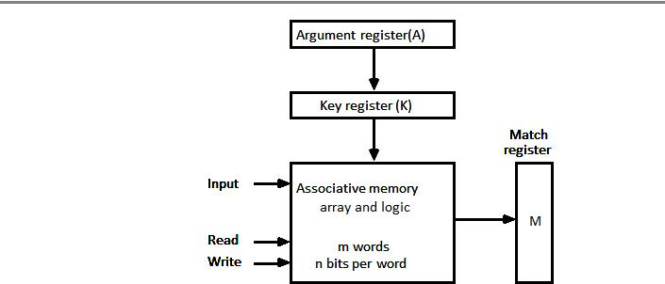
Block diagram of associative memory

Slide 30
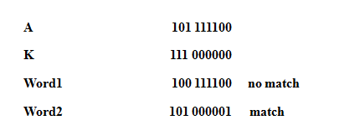
The key register provides a mask for choosing a particular field or key in the argument word.
The entire argument is compared with each memory word if the key register contains all 1's.
Otherwise, only those bits in the argument that have 1st in their corresponding position of the key register are compared.
Thus the key provides a mask or identifying piece of information which specifies how the reference to memory is made.
To illustrate with a numerical example, suppose that the argument register A and the key register K have the bit configuration shown below.
Only the three leftmost bits of A are compared with memory words because K has 1's in these position.

Slide 31
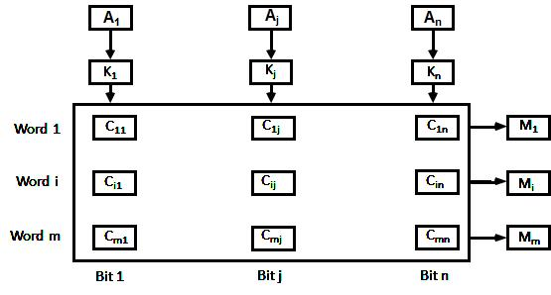
Associative memory of m word , n cell per word

Slide 32
CACHE MEMORY
Cache is a fast small capacity memory that should hold those information which are most likely to be accessed.
The basic operation of the cache is, when the CPU needs to access memory, the cache is examined.
If the word is found in the cache, it is read from the fast memory. If the word addressed by the CPU is not found in the cache, the main memory is accessed to read the word.
The transformation of data from main memory to cache memory is referred to as a mapping process.
Three types of mapping procedures are of practical interest when considering organization of main memory-
Associative mapping
Direct mapping
Set-associative mapping

Slide 33
Contd…
When the CPU refers to memory and finds the word in cache, it is said to produce a hit Otherwise, it is a miss
The performance of cache memory is frequently measured in terms of a quantity called hit ratio
Hit ratio = hit / (hit + miss)
The basic characteristic of cache memory is its fast access time,
Therefore, very little or no time must be wasted when searching the words in the cache
The transformation of data from main memory to cache memory is referred to as a mapping process, there are three types of mapping:
Associative mapping
Direct mapping
Set-associative mapping

Slide 34
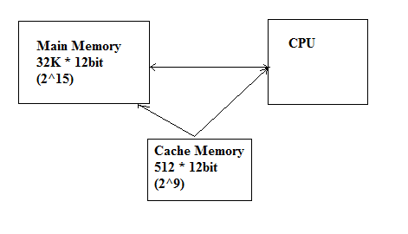
Contd…
To helping the discussion of these three mapping procedures we will use a specific example of a memory organization as shown in Fig:

Slide 35
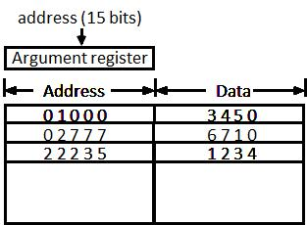
Associative mapping diagram-

Slide 36
Associative mapping
The associative memory stores both the address and content (data) of the memory word.
This permits any location in cache to store any word from main memory.
The figure shows three words presently stored in the cache. The address value of 15 bits is shown as a five-digit octal number and its corresponding 12-bit word is shown as a four-digit octal number.
A CPU address of 15 bits is placed in the argument register and the associative memory is searched for a matching address.
If the address is found the corresponding 12-bit data is read and sent to CPU.
If no match occurs, the main memory is accessed for the word.
The address data pairs then transferred to the associative cache memory.
If the cache is full, an address data pair must be displaced to make room for a pair that is needed and not presently in the cache.
This constitutes a first-in first-one (FIFO) replacement policy.

Slide 37
Direct Mapping
The CPU address of 15 bits is divided into two fields.
The nine least significant bits constitute the index field and the remaining six bits from the tag field.
The figure(in next slide) shows that main memory needs an address that includes both the tag and the index.
The number of bits in the index field is equal to the number of address bits required to access the cache memory.
Cache memory has size of 512 bytes, so 9 bits are required for index as 2⁹= 512.
In general case, if there are 2^{k} words in cache memory & 2^{n} works in main memory, then the n-bit memory address is divided into two fields : k bits for index field and n-k bits for tag field.

Slide 38
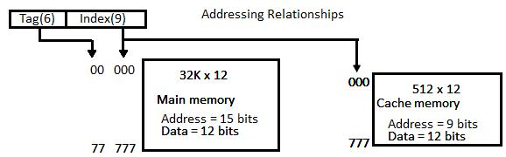
Direct Mapping

Slide 39
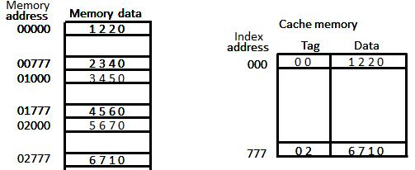
Each word in cache consists of the data word and its associated tag. When a new word is first brought into the cache, the tag bits are stored alongside the data bits. When the CPU generates a memory request the index field is used for the address to access the cache. The tag field of the CPU address is compared with the tag in the word read from the cache. If the two tags match, there is a hit and the desired data word is in cache. If there is no match, there is a miss and the required word is read from main memory. It is then stored in the cache together with the new tag, replacing the previous value. The word at address zero is presently stored in the cache (index = 000, tag = 00, data = 1220).

Slide 40
Suppose that the CPU now wants to access the word at address 02000.
The index address is 000, so it is used to access the cache. The two tags are then compared.
The cache tag is 000 but the address tag is 02, which does not produce a match.
Therefore, the main memory is accessed and the data word 5670 is transferred to the CPU.
The cache word at index address 000 is then replaced with a tag of 02 and data of 5670.
The disadvantage of direct mapping is that two words with the same index in their address but with different tag values cannot reside in cache memory at the same time.

Slide 41
Set-Associative Mapping
The disadvantage of direct mapping is that two words with the same index in their address but with different tag values cannot reside in cache memory at the same time
Set-Associative Mapping is an improvement over the direct-mapping in that each word of cache can store two or more word of memory under the same index address

Slide 42
Set-Associative Mapping
A third type of cache organization, called set associative mapping in that each word of cache can store two or more words of memory under the same index address.
Each data word is stored together with its tag and the number of tag-data items in one word of cache is said to form a set.
An example one set-associative cache organization for a set size of two is shown in figure (next to next slide)
Each index address refers to two data words and their associated terms.
Each tag required six bits and each data word has 12 bits, so the word length is 2 (6+12) = 36 bits.
An index address of nine bits can accommodate 512 words.
Thus the size of cache memory is 512 × 36. It can accommodate 1024 words or main memory since each word of cache contains two data words.
In generation a set-associative cache of set size k will accommodate K word of main memory in each word of cache.

Slide 43
Set-Associative Mapping
The octal numbers listed in figure are with reference to the main memory contents.
The words stored at addresses 01000 and 02000 of main memory are stored in cache memory at index address 000.
Similarly, the words at addresses 02777 and 00777 are stored in cache at index address 777.
When the CPU generates a memory request, the index value of the address is used to access the cache.
The tag field of the CPU address is then compared with both tags in the cache to determine if a match occurs.
The comparison logic is done by an associative search of the tags in the set similar to an associative memory search: thus the name "set-associative”.

Slide 44
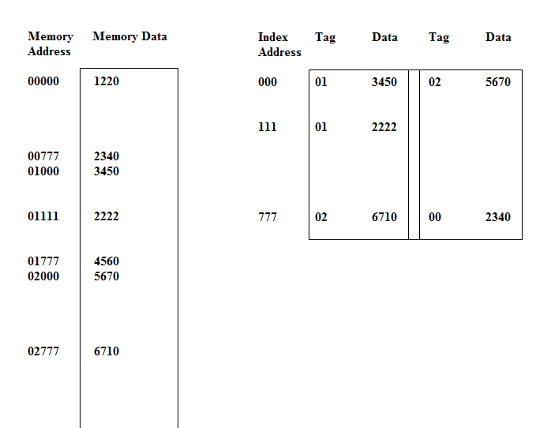
Set-Associative Mapping

Slide 45
Explain Write-through and Write-back cache write method.
An important aspect of cache organization is concerned with memory write requests. If the operation is write, there are two-ways that the system can proceed.
Write through
Write-back
Write Through
The simplest and most commonly used procedure is to update main memory with every memory write operation.
The cache memory being updated in parallel if it contains the word at the specified address. This is called the write-through method.
This method has the advantage that main memory always contains the same data as the cache.
This characteristic is important in systems with direct memory access transfers.
It ensures that the data residing in main memory are valid at all times so that an I/O device communicating through DMA would receive the most recent updated data.

Slide 46
Contd…
Write-Back (Copy-Back)
The second procedure is called the write-back method.
In this method only the cache location is updated during a write operation.
The location is then marked by a flag so that later when the word is removed from the cache it is copied into main memory.
The reason for the write-back method is that during the time a word resides in the cache, it may be updated several times.
However, as long as the word remains in the cache, it does not matter whether the copy in main memory is out of date, since requests from the word are filled from the cache.
It is only when the word is displaced from the cache that an accurate copy need be rewritten into main memory.

Slide 47
Virtual Memory
Virtual memory is used to give programmers the illusion that they have a very large memory at their disposal, even though the computer actually has a relatively small main memory.
A virtual memory system provides a mechanism for translating program-generated addresses into correct main memory locations.
Address space
An address used by a programmer will be called a virtual address, and the set of such addresses is known as address space.
Memory space
An address in main memory is called a location or physical address. The set of such locations is called the memory space.

Slide 48
Virtual Memory explanation-
As an illustration, consider a computer with a main-memory capacity of 32K words (K = 1024). Fifteen bits are needed to specify a physical address in memory since 32K = 2¹⁵.
Suppose that the computer has available auxiliary memory for storing 2²⁰ = 1024K words.
Thus auxiliary memory has a capacity for storing information equivalent to the capacity of 32 main memories.
Denoting the address space by N and the memory space by M, we then have for this example N = 1024K and M = 32K.
In a multiprogramming computer system, programs and data are transferred to and from auxiliary memory and main memory based on demands imposed by the CPU.

Slide 49
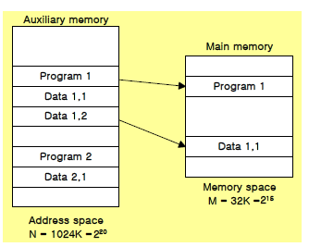
Virtual Memory
Suppose that program 1 is currently being executed in the CPU. Program 1 and a portion of its associated data are moved from auxiliary memory into main memory as shown in figure. .
Portions of programs and data need not be in contiguous locations in memory since information is being moved in and out, and empty spaces may be available in scattered locations in memory.
In our example, the address field of an instruction code will consist of 20 bits but physical memory addresses must be specified with only 15 bits.
Thus CPU will reference instructions and data with a 20-bit address, but the information at this address must be taken from physical memory because access to auxiliary storage for individual words will be too long.

Slide 50
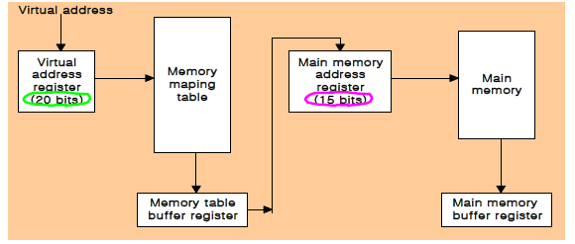
Fig: Memory table for mapping the virtual address

Slide 51
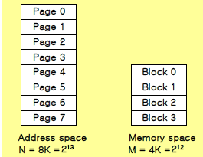
Address mapping using pages
The physical memory is broken down into groups of equal size called blocks.
The term page refers to group of address space of same size.
Consider a computer with an address space of 8K and a memory space of 4K.
If we split each into groups of 1K words we obtain 8 pages & four blocks as shown in diagram below
Fig: Address space and memory space split into groups of 1K words.

Slide 52
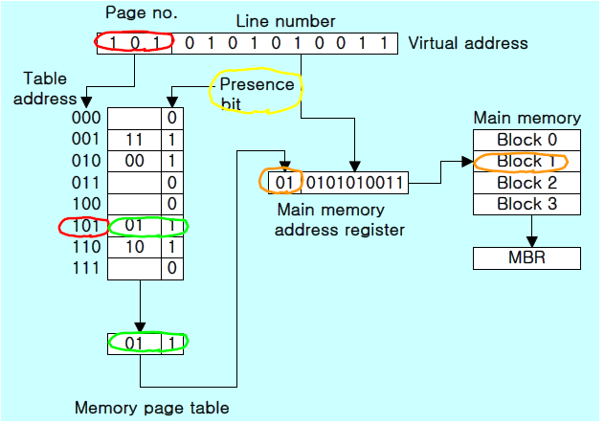
Memory table in a paged system

Slide 53
Explanation-
The size of address space is 8K i.e., 8 x1024 = 2^{13.}This means 13 bits are required for virtual address.
Similarly size of memory space is 4K i.e., 4 X 1024 = 2^{12..}This means 12 bits are required for physical address.
A virtual address is considered to be represented by 2 numbers = a page number address and a line within a page.
Virtual address = page number + line number
In a computer with 2^{p} words per page, p bits are used to specify a line address and remaining high-order bits of virtual address specify page number.
In our example, a virtual address has 13 bits. Since each page consists of 2¹⁰ = 1024 words, so 10 bits are required for line numbers and remaining 3 bits for page number.
Note- line address in address space & memory space is same, only mapping required is from a page number to a block number.

Slide 54
Contd…
So acc to our example, we have 8 pages in page table & 4 block is main memory.
The address in page table denotes the page number & content of the word gives the block number.
The table shows that pages 1,2,5 and 6 are available in main memory (as there presence bit is set to 1) in blocks 3,0,1 and 2 respectively.
A 0 in presence bit indicates that this page is not present in main memory.
The CPU references a word in memory with a virtual address of 13 bits.
The three high-order bits of the virtual address specify a page number and also an address for the memory-page table. The content of the word in the memory page table at the page number address is read out into the memory table buffer register.

Slide 55
Contd..
If the presence bit is a 1, the block number thus read is transferred to the two high-order bits of the main memory address register.
The line number from the virtual address is transferred into the 10 low- order bits of the memory address register.
A read signal to main memory transfers the content of the word to the main memory buffer register ready to be used by the CPU.

Slide 56
ASSOCIATIVE MEMORY PAGE TABLE
In the example of Address mapping using pages we observe that eight words of memory are needed, one for each page, but at least four words will always be marked empty because main memory cannot accommodate more than four blocks.
A more efficient way to organize the page table would be to construct it with a number of words equal to the number of blocks in main memory.
In this way the size of the memory is reduced and each location is fully utilized. This method can be implemented by means of an associative memory with each word in memory containing a page number together with its corresponding block number.
The page field in each word is compared with the page number in the virtual address. If a match occurs, the word is read from memory and its corresponding block number is extracted.

Slide 57
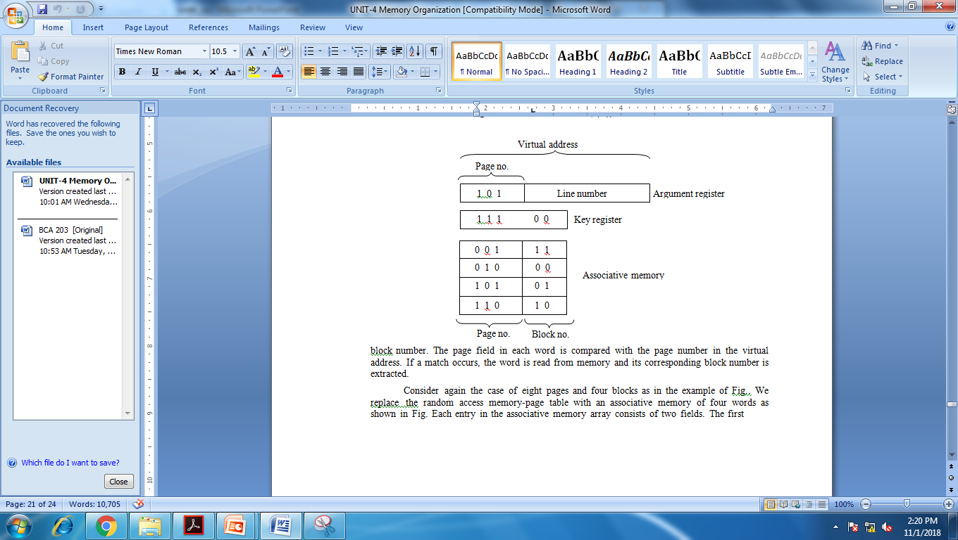
Diagram-
Consider again the case of eight pages and four blocks as in the example of Fig. We replace the random access memory-page table with an associative memory of four words as shown in Fig.

Slide 58
Explanation-
Each entry in the associative memory array consists of two fields.
The first three bits specify a field for storing the page number. The last two bits constitute a field for storing the block number.
The virtual address is placed in the argument register.
The page number bits in the argument are compared with all page numbers in the page field of the associative memory.
If the page number is found, the 5-bit word is read out from memory. The corresponding block number, being in the same word, is transferred to the main memory address register.
If no match occurs, a call to the operating system is generated to bring the required page from auxiliary memory.

Slide 59
Page replacement
When a program start execution, one or more pages are transferred into main memory and the page table is set to indicate their position.
The program is executed from main memory until it attempts to reference a page that is still in auxiliary memory. This condition is called page fault.
When page fault occurs, the execution of the present program is suspended until the required page is brought into main memory.
When a page fault occurs in a virtual memory system, it signifies that the page referenced by the CPU is not in main memory. A new page is then transferred from auxiliary memory to main memory.
The policy for choosing pages to remove is determined from the replacement algorithm that is used. The goal of a replacement policy is to try to remove the page least likely to be referenced in the immediate future. Two of the most common replacement algorithms used are the first-in first-out (FIFO) and the least recently used (LRU).

Slide 60
Fifo replacement algorithm-
The FIFO algorithm selects for replacement the page the has been in memory the longest time.
When a new page must be loaded, the page least recently brought in is removed. The page to be removed is easily determined because its identification number is at the top of the FIFO stack.
The FIFO replacement policy has the advantage of being easy to implement. It has the disadvantage that under certain circum-stances pages are removed and loaded form memory too frequently.

Slide 61
Least recently used Page replacement algorithm-
The LRU algorithm can be implemented by associating a counter with every page that is in main memory.
When a page is referenced, its associated counter is set to zero. At fixed intervals of time, the counters associated with all pages presently in memory are incremented by 1.
The least recently used page is the page with the highest count. The counters are often called aging registers, as their count indicates their age, that is, how long ago their associated pages have been referenced.

Slide 62
Memory management hardware
A memory management system is a collection hardware and software procedure for managing the various programs residing in the memory.
The memory management software is a part of overall operating system available in many computers.
The basic components of memory management unit are:
A facility for dynamic storage relocation that maps logical memory references into physical memory addresses.
A provision for sharing common programs stored in memory by different users.
Protection of information against unauthorized access between users and preventing users from changing operating system functions.

Slide 63
Memory management hardware
Segment:
A segment is a set of logically related instructions or data elements associated with a given name.
Segments may be generated by the programmer or by the operating system.
Logical Address:
The address is generated by a segmented program is called a logical address.

Slide 64
Explanation-
The logical address is partitioned into 3 fields i.e., segment field, page field and word field.
The segment field specifies a segment number.
The page field specifies the page within the segment and the word field gives the specific word within the page.
A page field of k-bits can specify up to 2^{k} pages.
A segment number may be associated with just one page or as many as 2^{k} pages.
The mapping of logical to physical address is being done by 2 tables.
The segment number of the logical address specifies the address of segment table.
The entry in segment table is a pointer address for a page table base.
The page table base is added to page number given in logical address.
The sum produces a pointer to an entry in page table.
The value found in page table provides the block number in physical memory.
The concatenation of block field with word field produces final physical mapped address.

Slide 65
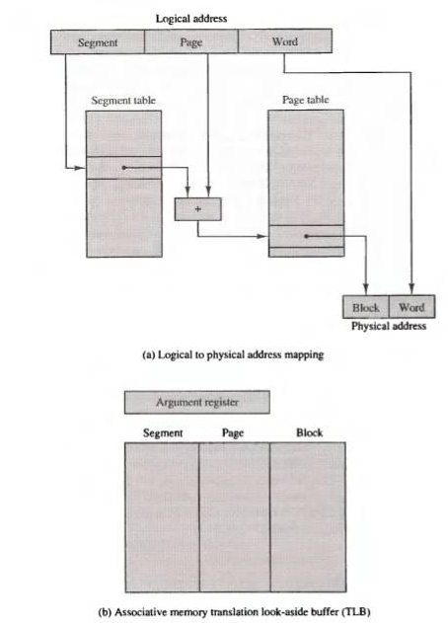
Segmented-page mapping

Slide 66
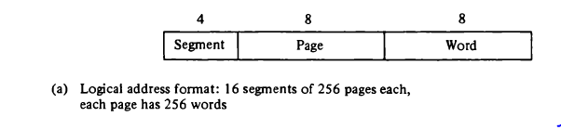
Numerical example-
Consider a 20 bit logical address specified in below figure. The 4-bit segment number specifies one of 16 possible segments.
The 8-bit word filed implies a page size of 256 words.
This configuration allows each segment to have any number of pages upto 256.

Slide 67
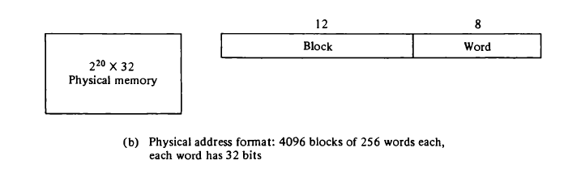
Contd..
The physical memory shown in below figure consists of 2²⁰ words of 32 bits each.
The 20 bit address is divided into 12 bit block number and 8-bit word number.

Slide 68
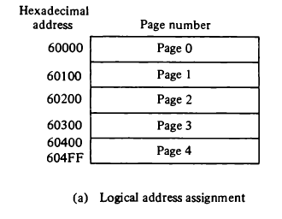
Contd…
Consider a program loaded into memory that requires 5 pages. The OS assign segment 6 and pages 0 through 4, as shown in below figure.
The total logical address range is from hexadecimal 60000 to 604FF.

Slide 69
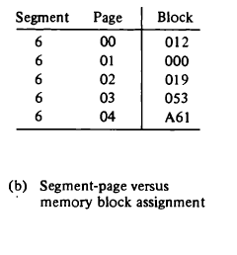
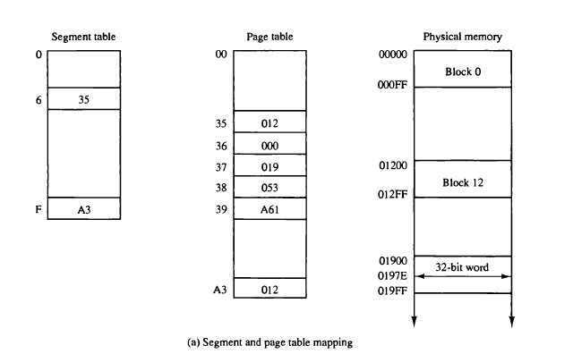
Contd…
The correspondence between each memory block & logical page number is shown in a table as
The information from above table in entered in segment & page table as shown below:

Slide 70

Contd…
Now consider the logical address given below:
The 20 bit logical address is listed as 5 digit hexadecimal number.
It refers to word number 7E of page number 02 and segment 6.
By viewing previous slide diagram we can see, the base of segment 6 in the page table is at address 35.
As segment 6 is associated with 5 pages so the range will be from 35 through 39.
Page 2 of segment 6 is at address 35 + 2 = 37.
The physical memory block at 37 is 019.
Word 7E in block 019 gives the 20-bit address 0197E.

